Slide 1
Characteristics of Software Mnemonic: CURE MR PM’S ST
1. Correctness: The ability of the software to perform its intended tasks effectively and meet user requirements.
2. Usability: The ease with which users can learn, operate, and navigate the software.
3. Reliability: The software's consistency in producing accurate results and maintaining performance over time.
4. Efficiency: The optimal use of system resources, such as memory and processing power, to achieve desired outcomes.

Slide 2
Characteristics of Software..
5. Maintainability: The ease of updating, modifying, and fixing the software to accommodate changing requirements or fix issues.
6. Portability: The ability of the software to operate on different platforms or environments without significant modifications.
7. Scalability: The software's capacity to handle increased workloads or user demands without compromising performance.
8. Security: The software's ability to protect against unauthorized access, data breaches, and other potential threats.

Slide 3
Characteristics of Software..
9. Modularity: The degree to which the software's components are organized into separate, manageable units that can be independently developed or updated.
10. Reusability: The potential for the software's components to be used in other applications or contexts, reducing development time and costs.
11. Testability: The ease with which the software can be tested to ensure it meets its requirements and performs as expected.

Slide 4
What is a System Engineer?
A system engineer is a professional who oversees the entire lifecycle of a complex system, from its initial conception to its final deployment. They are responsible for ensuring that a system meets its intended objectives while considering factors such as cost, performance, reliability, and maintainability.

Slide 5
Key responsibilities of a system engineer include:
Defining system requirements and specifications
Designing and developing system architectures
Integrating hardware and software components
Ensuring system performance and reliability
Troubleshooting and resolving system issues
Managing system upgrades and maintenance
System engineers often work in collaboration with software engineers, hardware engineers, and other technical professionals to create and maintain complex systems. They play a crucial role in ensuring that systems meet the needs of their users and organizations.

Slide 6
What is a Software Engineer?
A software engineer is a professional who specializes in designing, developing, testing, and maintaining software applications. They use their programming skills to create software solutions that solve problems and meet the needs of users.

Slide 7
Key responsibilities of a software engineer include:
Writing and debugging code using programming languages
Designing and implementing software architectures
Testing software for functionality and performance
Collaborating with other team members, including system engineers and designers
Staying up-to-date with the latest software development technologies and trends
Software engineers can work in a variety of industries, including technology, finance, healthcare, and gaming. They play a vital role in the development of software applications that drive innovation and improve people’s lives.

Slide 8
System vs Software Engineering
Feature | System Engineer | Software Engineer
Area of Focus | Overall IT infrastructure (hardware, software, networks) | Software applications (code development, functionality, user experience)
Skillsets | – Infrastructure knowledge (hardware, software, networking) – Network administration (protocols, configuration, security) – Troubleshooting – System integration – Security best practices | – Programming languages (specific languages vary) – Software design principles (OOP, design patterns, clean code) – Testing methodologies (unit, integration, user acceptance) – Problem-solving – Version control systems (e.g., Git) – Agile methodologies – Databases

Slide 9
System vs Software Engineering..
Feature | System Engineer | Software Engineer
Nature of Job | Interdisciplinary nature: Involves collaboration with professionals from various engineering disciplines | Specialized Focus: Not much collaboration included.
Job Responsibilities | – Design, implement, and maintain complex systems (hardware, software, networks) – Oversee system integration and performance – Manage system security and troubleshoot issues – Collaborate with cross-functional teams – Provide technical support | –Design and develop software systems – Analyze user requirements – Implement software features based on specifications – Develop and test individual functionalities – Debug and fix software – UI/UX Design in some cases – Software maintenance and updates

Slide 10
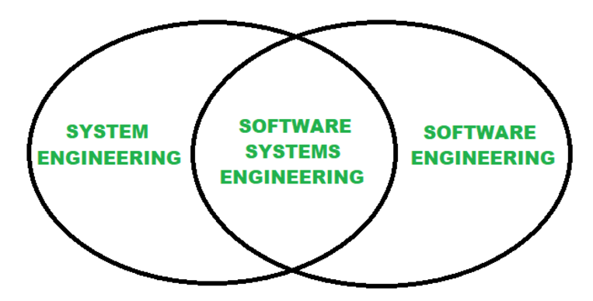
System vs Software Engineering..

Slide 11
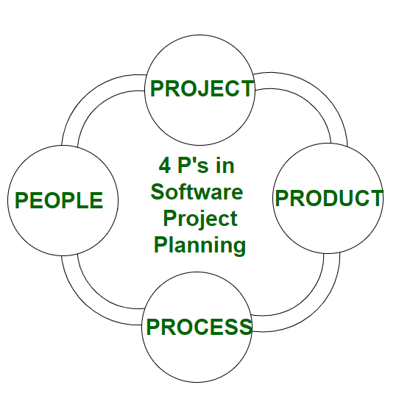
Four Ps of Software Project Management
1. People:
The most important component of a product and its successful implementation is human resources. In building a proper product, a well-managed team with clear-cut roles defined for each person/team will lead to the success of the product. Some assigned roles in software project planning are project manager, team leaders, stakeholders, analysts, and other IT professionals. Managing people successfully is a tricky process which a good project manager can do.
2. Product:
This is the deliverable or the result of the project. The project manager should clearly define the product scope to ensure a successful result, control the team members.

Slide 12
Four Ps of Software Project Management..
3. Process:
In every planning, a clearly defined process is the key to the success of any product. It regulates how the team will go about its development in the respective time period. The Process has several steps involved like, documentation phase, implementation phase, deployment phase, and interaction phase.
4. Project:
The last and final P in software project planning is Project. It can also be considered as a blueprint of process. In this phase, the project manager plays a critical role. They are responsible to guide the team members to achieve the project’s target and objectives, helping & assisting them with issues, and making sure that the project stays on track with the given deadlines.

